Slide 1
Lecture 22-23 Graphs

Slide 2
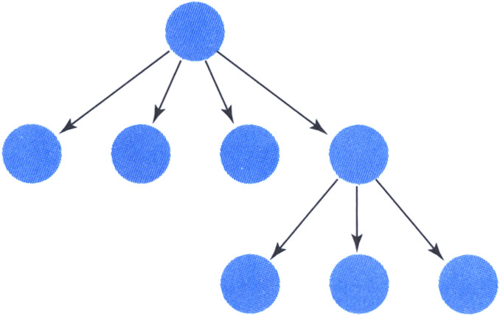
Graphs
Recap: The tree data structure
Nodes
Parent-child relation between two nodes
Remove the restriction that each node may have only one parent node
We have a graph
a
b
c
d
e

Slide 3
Graphs
Graph: A data structure that consists of a set of nodes and a set of connections that relate the nodes to one another
Vertex: A node in a graph
Edge (arc): A pair of vertices representing a connection between two nodes in a graph
Undirected graph: A graph in which the edges have no direction
Directed graph (digraph): A graph in which each edge is directed from one vertex to another (or the same) vertex
a
b
a
b
vertex
c
edge
c
d
e
d
e
Undirected graph
Directed graph

Slide 4
Graphs
A graph G is represented as G = (V,E), where
V: set of vertices
E: set of edges connecting the vertices in V
An edge e = (u,v) is a pair of vertices
Example:
a
b
V= {a,b,c,d,e}
E= {(a,b),(a,c),(a,d),
(b,e),(c,d),(c,e), (d,e)}
c
d
e

Slide 5
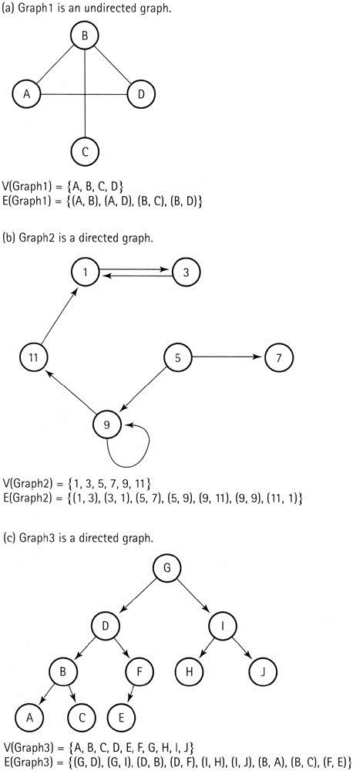
Graphs
Example: Graph1

Slide 6
Graphs
Example: Graph2

Slide 7
Graphs
Example: Graph3

Slide 8
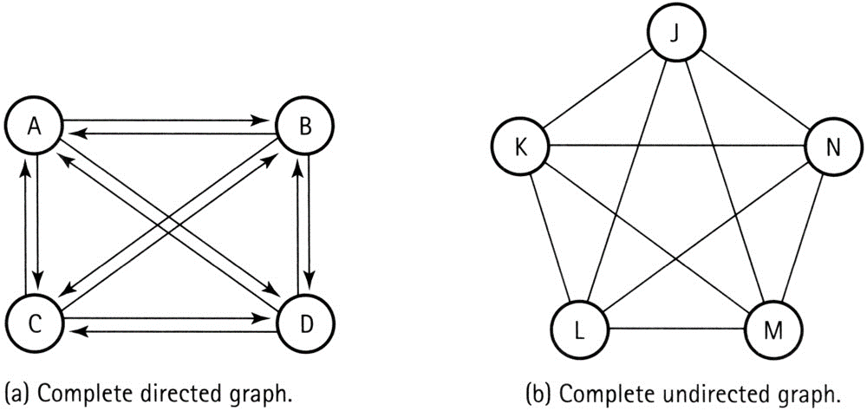
Graphs
Complete graph: A graph in which every vertex is directly connected to every other vertex

Slide 9
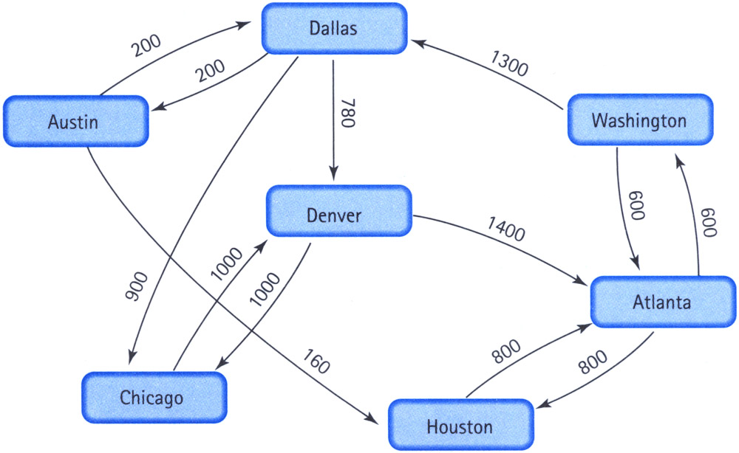
Graphs
Weighted graph: A graph in which each edge carries a value (cost)

Slide 10
Graphs
Adjacent vertices: Two vertices in a graph that are connected by an edge
Path: A sequence of vertices that connects two nodes in a graph

Slide 11
Implementation Issues
How can we store a graph in memory?
 | [0] | [1] | [2] | [3] | [4] | [5] | [6] | [7] | [8] | [9]
[0] | 0 | 0 | 0 | 0 | 0 | 800 | 600
[1] | 0 | 0 | 0 | 200 | 0 | 160 | 0
[2] | 0 | 0 | 0 | 0 | 1000 | 0 | 0
[3] | 0 | 200 | 900 | 0 | 780 | 0 | 0
[4] | 1400 | 0 | 1000 | 0 | 0 | 0 | 0
[5] | 800 | 0 | 0 | 0 | 0 | 0 | 0
[6] | 600 | 0 | 0 | 1300 | 0 | 0 | 0
[7]
[8]
[9]
0 | Atlanta
1 | Austin
2 | Chicago
3 | Dallas
4 | Denver
5 | Houston
6 | Washington
7
8
9
Vertices
Edges

Slide 12
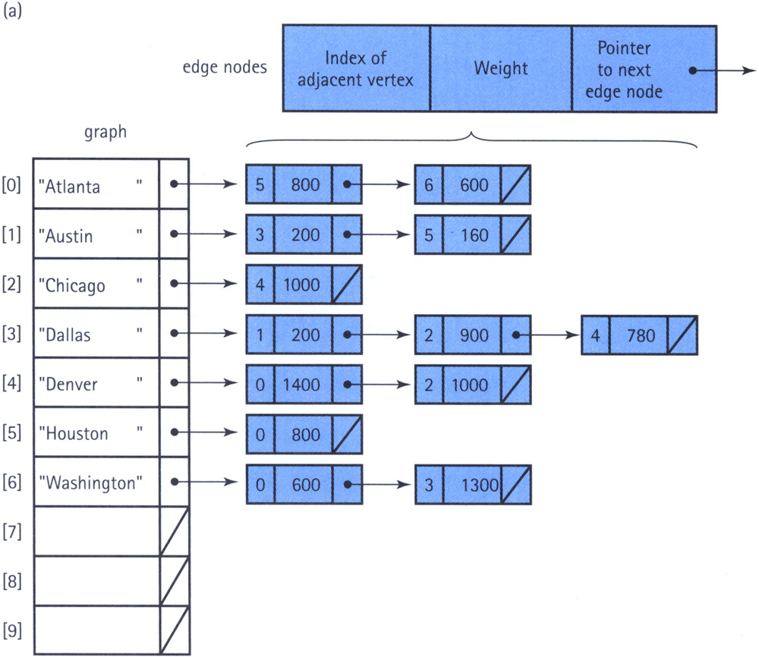
Implementation Issues
How can we store a graph in memory?
Vertices
Edges

Slide 13
Graph Specification
Structure: | The graph consists of a set of vertices and a set of weighted edges that connect some or all of the vertices to one another.
Operations:
MakeEmpty
Function | Initializes the graph to an empty state.
Postcondition | Graph is empty.
Boolean IsEmpty
Function | Tests whether the graph is empty.
Postcondition | Returns true if graph is empty and false otherwise.
Boolean IsFull
Function | Tests whether the graph is full.
Postcondition | Returns true if graph is full and false otherwise.

Slide 14
Graph Specification
AddVertex(VertexType vertex)
Function | Adds vertex to the graph.
Precondition | Graph is not full.
Postcondition | vertex is in V(graph).
AddEdge(VertexType fromVertex, VertexType toVertex, EdgeValueType weight)
Function | Adds an edge with the specified weight from fromVertex to toVertex.
Precondition | fromVertex and toVertex are in V(graph).
Postcondition | (fromVertex, toVertex) is in E(graph) with the specified weight.

Slide 15
Graph Specification
EdgeValueType WeightIs(VertexType fromVertex, VertexType toVertex)
Function | Determines the weight of the edge from fromVertex to toVertex.
Precondition | fromVertex and toVertex are in V(graph).
Postcondition | Function value = weight of edge from fromVertex to toVertex, if edge exists. If edge does not exist, function value = special "null-edge" value.
GetToVertices(VertexType vertex, QueType& vertexQ)
Function | Returns a queue of the vertices that are adjacent from vertex.
Precondition | vertex is in V(graph).
Postcondition | vertexQ contains the names of all vertices that are adjacent from vertex.

Slide 16
graphtype.h
#include "QueType.h"
template<class VertexType>
class GraphType
{
public:
GraphType();
GraphType(int maxV);
~GraphType();
void MakeEmpty();
bool IsEmpty() const;
bool IsFull() const;
void AddVertex(VertexType);
void AddEdge(VertexType, VertexType, int);
int WeightIs(VertexType, VertexType);
void GetToVertices(VertexType, QueType<VertexType>&);
void ClearMarks();
void MarkVertex(VertexType);
bool IsMarked(VertexType);
private:
int numVertices;
int maxVertices;
VertexType* vertices;
int **edges;
bool* marks;
};

Slide 17
graphtype.cpp
#include "GraphType.h"
template<class VertexType>
GraphType<VertexType>::GraphType()
{
numVertices = 0;
maxVertices = 50;
vertices = new VertexType[50];
edges = new int*[50];
for(int i=0;i<50;i++)
edges[i] = new int [50];
marks = new bool[50];
}
template<class VertexType>
GraphType<VertexType>::GraphType(int maxV)
{
numVertices = 0;
maxVertices = maxV;
vertices = new VertexType[maxV];
edges = new int*[maxV];
for(int i=0;i<maxV;i++)
edges[i] = new int [maxV];
marks = new bool[maxV];
}

Slide 18
graphtype.cpp
template<class VertexType>
GraphType<VertexType>::~GraphType()
{
delete [] vertices;
delete [] marks;
for(int i=0;i<maxV;i++)
delete [] edges[i];
delete [] edges;
}
const int NULL_EDGE = 0;
template<class VertexType>
void GraphType<VertexType>::AddVertex(VertexType vertex)
{
vertices[numVertices] = vertex;
for (int index = 0; index < numVertices; index++)
{
edges[numVertices][index] = NULL_EDGE;
edges[index][numVertices] = NULL_EDGE;
}
numVertices++;
}

Slide 19
graphtype.cpp
template<class VertexType>
int IndexIs(VertexType* vertices, VertexType vertex)
{
int index = 0;
while (!(vertex == vertices[index]))
index++;
return index;
}
template<class VertexType>
void GraphType<VertexType>::AddEdge(VertexType fromVertex,
VertexType toVertex, int weight)
{
int row = IndexIs(vertices, fromVertex);
int col= IndexIs(vertices, toVertex);
edges[row][col] = weight;
}

Slide 20
graphtype.cpp
template<class VertexType>
int GraphType<VertexType>::WeightIs(VertexType fromVertex, VertexType toVertex)
{
int row = IndexIs(vertices, fromVertex);
int col= IndexIs(vertices, toVertex);
return edges[row][col];
}
template<class VertexType>
void GraphType<VertexType>::GetToVertices(VertexType vertex, QueType<VertexType>& adjVertices)
{
int fromIndex;
int toIndex;
fromIndex = IndexIs(vertices, vertex);
for (toIndex = 0; toIndex < numVertices; toIndex++)
if (edges[fromIndex][toIndex] != NULL_EDGE)
adjVertices.Enqueue(vertices[toIndex]);
}

Slide 23
Unfinished Business
ClearMarks
Function | Sets marks for all vertices to false.
Postcondition | All marks have been set to false.
MarkVertex(VertexType vertex)
Function | Sets mark for vertex to true.
Precondition | vertex is in V(graph).
Postcondition | IsMarked(vertex) is true.
Boolean IsMarked(VertexType vertex)
Function | Determines if vertex has been marked.
Precondition | vertex is in V(graph)
Postcondition | Returns true if vertex is marked and false otherwise

Slide 24
Depth-First Search
Depth-first search is a strategy for exploring a graph and find path between two vertices
Explore “deeper” in the graph whenever possible
Edges are explored out of the most recently discovered vertex v that still has unexplored edges
When all of v’s edges have been explored, backtrack to the vertex from which v was discovered

Slide 25
Depth-First Search
Set found to false
stack.Push(startVertex)
do
stack.Pop(vertex)
if vertex = endVertex
Write final vertex
Set found to true
else if vertex is unvisited
Write this vertex
Push all unvisited adjacent vertices onto stack
while !stack.IsEmpty() AND !found
if(!found)
Write "Path does not exist"

Slide 26
Depth-First Search
Example: Conduct a depth-first search in the graph and find if there is a path from D to B
F
C
A
B
D
H
G
E

Slide 27
Depth-First Search
Example: Conduct a depth-first search in the graph and find if there is a path from D to B
vertices
marks
stack
found
F
C
[0] | A
[1] | B
[2] | C
[3] | D
[4] | E
[5] | F
[6] | G
[7] | H
[0]
[1]
[2]
[3]
[4]
[5]
[6]
[7]
A
B
D
H
G
E
Visited nodes:

Slide 28
Depth-First Search
Example: Conduct a depth-first search in the graph and find if there is a path from D to B
vertices
marks
stack
found
F
C
[0] | A
[1] | B
[2] | C
[3] | D
[4] | E
[5] | F
[6] | G
[7] | H
[0]
[1]
[2]
[3]
[4]
[5]
[6]
[7]
A
B
D
H
G
E
Visited nodes:
Clear the marks (set to false). Push D onto the stack. Set found to false.

Slide 29
Depth-First Search
Example: Conduct a depth-first search in the graph and find if there is a path from D to B
vertices
marks
stack
found
F
C
false
[0] | A
[1] | B
[2] | C
[3] | D
[4] | E
[5] | F
[6] | G
[7] | H
D
[0] | 0
[1] | 0
[2] | 0
[3] | 0
[4] | 0
[5] | 0
[6] | 0
[7] | 0
A
B
D
H
G
E
Visited nodes:
Clear the marks (set to false). Push D onto the stack. Set found to false.

Slide 30
Depth-First Search
Example: Conduct a depth-first search in the graph and find if there is a path from D to B
vertices
marks
stack
found
F
C
false
[0] | A
[1] | B
[2] | C
[3] | D
[4] | E
[5] | F
[6] | G
[7] | H
D
[0] | 0
[1] | 0
[2] | 0
[3] | 0
[4] | 0
[5] | 0
[6] | 0
[7] | 0
A
B
D
H
G
E
Visited nodes:
Pop from stack (D is popped). D is not visited yet (unmarked). So, visit D (set D as marked).

Slide 31
Depth-First Search
Example: Conduct a depth-first search in the graph and find if there is a path from D to B
vertices
marks
stack
found
F
C
[0] | A
[1] | B
[2] | C
[3] | D
[4] | E
[5] | F
[6] | G
[7] | H
false
[0] | 0
[1] | 0
[2] | 0
[3] | 1
[4] | 0
[5] | 0
[6] | 0
[7] | 0
A
B
D
H
G
E
Visited nodes:
D
Pop from stack (D is popped). D is not visited yet (unmarked). So, visit D (set D as marked).

Slide 32
Depth-First Search
Example: Conduct a depth-first search in the graph and find if there is a path from D to B
vertices
marks
stack
found
F
C
[0] | A
[1] | B
[2] | C
[3] | D
[4] | E
[5] | F
[6] | G
[7] | H
false
[0] | 0
[1] | 0
[2] | 0
[3] | 1
[4] | 0
[5] | 0
[6] | 0
[7] | 0
A
B
D
H
G
E
Visited nodes:
D
Push all the vertices that are adjacent to D and unvisited (unmarked) onto the stack (C, E and F are pushed).

Slide 33
Depth-First Search
Example: Conduct a depth-first search in the graph and find if there is a path from D to B
vertices
marks
stack
found
F
C
false
[0] | A
[1] | B
[2] | C
[3] | D
[4] | E
[5] | F
[6] | G
[7] | H
F
E
C
[0] | 0
[1] | 0
[2] | 0
[3] | 1
[4] | 0
[5] | 0
[6] | 0
[7] | 0
A
B
D
H
G
E
Visited nodes:
D
Push all the vertices that are adjacent to D and unvisited (unmarked) onto the stack (C, E and F are pushed).

Slide 34
Depth-First Search
Example: Conduct a depth-first search in the graph and find if there is a path from D to B
vertices
marks
stack
found
F
C
false
[0] | A
[1] | B
[2] | C
[3] | D
[4] | E
[5] | F
[6] | G
[7] | H
F
E
C
[0] | 0
[1] | 0
[2] | 0
[3] | 1
[4] | 0
[5] | 0
[6] | 0
[7] | 0
A
B
D
H
G
E
Visited nodes:
D
Pop from stack (F is popped). F is not visited yet (unmarked). So, visit F (set F as marked).

Slide 35
Depth-First Search
Example: Conduct a depth-first search in the graph and find if there is a path from D to B
vertices
marks
stack
found
F
C
false
[0] | A
[1] | B
[2] | C
[3] | D
[4] | E
[5] | F
[6] | G
[7] | H
E
C
[0] | 0
[1] | 0
[2] | 0
[3] | 1
[4] | 0
[5] | 1
[6] | 0
[7] | 0
A
B
D
H
G
E
Visited nodes:
D F
Pop from stack (F is popped). F is not visited yet (unmarked). So, visit F (set F as marked).

Slide 36
Depth-First Search
Example: Conduct a depth-first search in the graph and find if there is a path from D to B
vertices
marks
stack
found
F
C
false
[0] | A
[1] | B
[2] | C
[3] | D
[4] | E
[5] | F
[6] | G
[7] | H
E
C
[0] | 0
[1] | 0
[2] | 0
[3] | 1
[4] | 0
[5] | 1
[6] | 0
[7] | 0
A
B
D
H
G
E
Visited nodes:
D F
Push all the vertices that are adjacent to F and unvisited (unmarked) onto the stack (C is pushed).

Slide 37
Depth-First Search
Example: Conduct a depth-first search in the graph and find if there is a path from D to B
vertices
marks
stack
found
F
C
false
[0] | A
[1] | B
[2] | C
[3] | D
[4] | E
[5] | F
[6] | G
[7] | H
C
E
C
[0] | 0
[1] | 0
[2] | 0
[3] | 1
[4] | 0
[5] | 1
[6] | 0
[7] | 0
A
B
D
H
G
E
Visited nodes:
D F
Push all the vertices that are adjacent to F and unvisited (unmarked) onto the stack (C is pushed).

Slide 38
Depth-First Search
Example: Conduct a depth-first search in the graph and find if there is a path from D to B
vertices
marks
stack
found
F
C
false
[0] | A
[1] | B
[2] | C
[3] | D
[4] | E
[5] | F
[6] | G
[7] | H
C
E
C
[0] | 0
[1] | 0
[2] | 0
[3] | 1
[4] | 0
[5] | 1
[6] | 0
[7] | 0
A
B
D
H
G
E
Visited nodes:
D F
Pop from stack (C is popped). C is not visited yet (unmarked). So, visit C (set C as marked).

Slide 39
Depth-First Search
Example: Conduct a depth-first search in the graph and find if there is a path from D to B
vertices
marks
stack
found
F
C
false
[0] | A
[1] | B
[2] | C
[3] | D
[4] | E
[5] | F
[6] | G
[7] | H
E
C
[0] | 0
[1] | 0
[2] | 1
[3] | 1
[4] | 0
[5] | 1
[6] | 0
[7] | 0
A
B
D
H
G
E
Visited nodes:
D F C
Pop from stack (C is popped). C is not visited yet (unmarked). So, visit C (set C as marked).

Slide 40
Depth-First Search
Example: Conduct a depth-first search in the graph and find if there is a path from D to B
vertices
marks
stack
found
F
C
false
[0] | A
[1] | B
[2] | C
[3] | D
[4] | E
[5] | F
[6] | G
[7] | H
E
C
[0] | 0
[1] | 0
[2] | 1
[3] | 1
[4] | 0
[5] | 1
[6] | 0
[7] | 0
A
B
D
H
G
E
Visited nodes:
D F C
Push all the vertices that are adjacent to C and unvisited (unmarked) onto the stack (nothing is pushed).

Slide 41
Depth-First Search
Example: Conduct a depth-first search in the graph and find if there is a path from D to B
vertices
marks
stack
found
F
C
false
[0] | A
[1] | B
[2] | C
[3] | D
[4] | E
[5] | F
[6] | G
[7] | H
E
C
[0] | 0
[1] | 0
[2] | 1
[3] | 1
[4] | 0
[5] | 1
[6] | 0
[7] | 0
A
B
D
H
G
E
Visited nodes:
D F C
Pop from stack (E is popped). E is not visited yet (unmarked). So, visit E (set E as marked).

Slide 42
Depth-First Search
Example: Conduct a depth-first search in the graph and find if there is a path from D to B
vertices
marks
stack
found
F
C
false
[0] | A
[1] | B
[2] | C
[3] | D
[4] | E
[5] | F
[6] | G
[7] | H
C
[0] | 0
[1] | 0
[2] | 1
[3] | 1
[4] | 1
[5] | 1
[6] | 0
[7] | 0
A
B
D
H
G
E
Visited nodes:
D F C E
Pop from stack (E is popped). E is not visited yet (unmarked). So, visit E (set E as marked).

Slide 43
Depth-First Search
Example: Conduct a depth-first search in the graph and find if there is a path from D to B
vertices
marks
stack
found
F
C
false
[0] | A
[1] | B
[2] | C
[3] | D
[4] | E
[5] | F
[6] | G
[7] | H
C
[0] | 0
[1] | 0
[2] | 1
[3] | 1
[4] | 1
[5] | 1
[6] | 0
[7] | 0
A
B
D
H
G
E
Visited nodes:
D F C E
Push all the vertices that are adjacent to E and unvisited (unmarked) onto the stack (G is pushed).

Slide 44
Depth-First Search
Example: Conduct a depth-first search in the graph and find if there is a path from D to B
vertices
marks
stack
found
F
C
false
[0] | A
[1] | B
[2] | C
[3] | D
[4] | E
[5] | F
[6] | G
[7] | H
G
C
[0] | 0
[1] | 0
[2] | 1
[3] | 1
[4] | 1
[5] | 1
[6] | 0
[7] | 0
A
B
D
H
G
E
Visited nodes:
D F C E
Push all the vertices that are adjacent to E and unvisited (unmarked) onto the stack (G is pushed).

Slide 45
Depth-First Search
Example: Conduct a depth-first search in the graph and find if there is a path from D to B
vertices
marks
stack
found
F
C
false
[0] | A
[1] | B
[2] | C
[3] | D
[4] | E
[5] | F
[6] | G
[7] | H
G
C
[0] | 0
[1] | 0
[2] | 1
[3] | 1
[4] | 1
[5] | 1
[6] | 0
[7] | 0
A
B
D
H
G
E
Visited nodes:
D F C E
Pop from stack (G is popped). G is not visited yet (unmarked). So, visit G (set G as marked).

Slide 46
Depth-First Search
Example: Conduct a depth-first search in the graph and find if there is a path from D to B
vertices
marks
stack
found
F
C
false
[0] | A
[1] | B
[2] | C
[3] | D
[4] | E
[5] | F
[6] | G
[7] | H
C
[0] | 0
[1] | 0
[2] | 1
[3] | 1
[4] | 1
[5] | 1
[6] | 1
[7] | 0
A
B
D
H
G
E
Visited nodes:
D F C E G
Pop from stack (G is popped). G is not visited yet (unmarked). So, visit G (set G as marked).

Slide 47
Depth-First Search
Example: Conduct a depth-first search in the graph and find if there is a path from D to B
vertices
marks
stack
found
F
C
false
[0] | A
[1] | B
[2] | C
[3] | D
[4] | E
[5] | F
[6] | G
[7] | H
C
[0] | 0
[1] | 0
[2] | 1
[3] | 1
[4] | 1
[5] | 1
[6] | 1
[7] | 0
A
B
D
H
G
E
Visited nodes:
D F C E G
Push all the vertices that are adjacent to G and unvisited (unmarked) onto the stack (H is pushed).

Slide 48
Depth-First Search
Example: Conduct a depth-first search in the graph and find if there is a path from D to B
vertices
marks
stack
found
F
C
false
[0] | A
[1] | B
[2] | C
[3] | D
[4] | E
[5] | F
[6] | G
[7] | H
H
C
[0] | 0
[1] | 0
[2] | 1
[3] | 1
[4] | 1
[5] | 1
[6] | 1
[7] | 0
A
B
D
H
G
E
Visited nodes:
D F C E G
Push all the vertices that are adjacent to G and unvisited (unmarked) onto the stack (H is pushed).

Slide 49
Depth-First Search
Example: Conduct a depth-first search in the graph and find if there is a path from D to B
vertices
marks
stack
found
F
C
false
[0] | A
[1] | B
[2] | C
[3] | D
[4] | E
[5] | F
[6] | G
[7] | H
H
C
[0] | 0
[1] | 0
[2] | 1
[3] | 1
[4] | 1
[5] | 1
[6] | 1
[7] | 0
A
B
D
H
G
E
Visited nodes:
D F C E G
Pop from stack (H is popped). H is not visited yet (unmarked). So, visit H (set H as marked).

Slide 50
Depth-First Search
Example: Conduct a depth-first search in the graph and find if there is a path from D to B
vertices
marks
stack
found
F
C
false
[0] | A
[1] | B
[2] | C
[3] | D
[4] | E
[5] | F
[6] | G
[7] | H
C
[0] | 0
[1] | 0
[2] | 1
[3] | 1
[4] | 1
[5] | 1
[6] | 1
[7] | 1
A
B
D
H
G
E
Visited nodes:
D F C E G H
Pop from stack (H is popped). H is not visited yet (unmarked). So, visit H (set H as marked).

Slide 51
Depth-First Search
Example: Conduct a depth-first search in the graph and find if there is a path from D to B
vertices
marks
stack
found
F
C
false
[0] | A
[1] | B
[2] | C
[3] | D
[4] | E
[5] | F
[6] | G
[7] | H
C
[0] | 0
[1] | 0
[2] | 1
[3] | 1
[4] | 1
[5] | 1
[6] | 1
[7] | 1
A
B
D
H
G
E
Visited nodes:
D F C E G H
Push all the vertices that are adjacent to H and unvisited (unmarked) onto the stack (A and B are pushed).

Slide 52
Depth-First Search
Example: Conduct a depth-first search in the graph and find if there is a path from D to B
vertices
marks
stack
found
F
C
false
[0] | A
[1] | B
[2] | C
[3] | D
[4] | E
[5] | F
[6] | G
[7] | H
B
A
C
[0] | 0
[1] | 0
[2] | 1
[3] | 1
[4] | 1
[5] | 1
[6] | 1
[7] | 1
A
B
D
H
G
E
Visited nodes:
D F C E G H
Push all the vertices that are adjacent to H and unvisited (unmarked) onto the stack (A and B are pushed).

Slide 53
Depth-First Search
Example: Conduct a depth-first search in the graph and find if there is a path from D to B
vertices
marks
stack
found
F
C
false
[0] | A
[1] | B
[2] | C
[3] | D
[4] | E
[5] | F
[6] | G
[7] | H
B
A
C
[0] | 0
[1] | 0
[2] | 1
[3] | 1
[4] | 1
[5] | 1
[6] | 1
[7] | 1
A
B
D
H
G
E
Visited nodes:
D F C E G H
Pop from stack (B is popped). B is not visited yet (unmarked). So, visit B (set B as marked).

Slide 54
Depth-First Search
Example: Conduct a depth-first search in the graph and find if there is a path from D to B
vertices
marks
stack
found
F
C
false
[0] | A
[1] | B
[2] | C
[3] | D
[4] | E
[5] | F
[6] | G
[7] | H
A
C
[0] | 0
[1] | 1
[2] | 1
[3] | 1
[4] | 1
[5] | 1
[6] | 1
[7] | 1
A
B
D
H
G
E
Visited nodes:
D F C E G H B
Pop from stack (B is popped). B is not visited yet (unmarked). So, visit B (set B as marked).

Slide 55
Depth-First Search
Example: Conduct a depth-first search in the graph and find if there is a path from D to B
vertices
marks
stack
found
F
C
false
[0] | A
[1] | B
[2] | C
[3] | D
[4] | E
[5] | F
[6] | G
[7] | H
A
C
[0] | 0
[1] | 1
[2] | 1
[3] | 1
[4] | 1
[5] | 1
[6] | 1
[7] | 1
A
B
D
H
G
E
Visited nodes:
D F C E G H B
B is the destination vertex. So set found to true (there is a path). Search is complete.
Note: We can still carry on with the search (until the stack is empty).

Slide 56
Depth-First Search
Example: Conduct a depth-first search in the graph and find if there is a path from D to B
vertices
marks
stack
found
F
C
true
[0] | A
[1] | B
[2] | C
[3] | D
[4] | E
[5] | F
[6] | G
[7] | H
A
C
[0] | 0
[1] | 1
[2] | 1
[3] | 1
[4] | 1
[5] | 1
[6] | 1
[7] | 1
A
B
D
H
G
E
Visited nodes:
D F C E G H B
B is the destination vertex. So set found to true (there is a path). Search is complete.
Note: We can still carry on with the search (until the stack is empty).

Slide 57
Depth-First Search
Depth-First Search yields a tree (the path taken during the search) also known as the Depth-First Tree.
F
C
A
B
D
H
G
E

Slide 58
Depth-First Search
template<class VertexType>
void DepthFirstSearch(GraphType<VertexType> graph,
VertexType startVertex, VertexType endVertex)
{
StackType<VertexType> stack;
QueType<VertexType> vertexQ;
bool found = false;
VertexType vertex;
VertexType item;
graph.ClearMarks();
stack.Push(startVertex);
do
{
stack.Pop(vertex);
if (vertex == endVertex)
{
cout << vertex);
found = true;
}

Slide 59
Depth-First Search
else
{
if (!graph.IsMarked(vertex))
{
graph.MarkVertex(vertex);
cout << vertex;
graph.GetToVertices(vertex, vertexQ);
while (!vertexQ.IsEmpty())
{
vertexQ.Dequeue(item);
if (!graph.IsMarked(item))
stack.Push(item);
}
}
}
} while (!stack.IsEmpty() && !found);
if (!found)
cout << "Path not found." << endl;
}

Slide 60
Breadth-First Search
Breadth-first search is a strategy for exploring a graph and find path between two vertices
Explore “level by level” in the graph

Slide 61
Breadth-First Search
Breadth-first search starts with given node
F
C
A
B
D
H
0
G
E
Task: Conduct a breadth-first search of the graph starting with node D

Slide 62
Breadth-First Search
Breadth-first search starts with given node
Then visits nodes adjacent in some specified order (e.g., alphabetical)
Like ripples in a pond
F
C
A
B
D
H
0
G
E
1
Nodes visited: D

Slide 63
Breadth-First Search
Breadth-first search starts with given node
Then visits nodes adjacent in some specified order (e.g., alphabetical)
Like ripples in a pond
F
C
A
B
D
H
0
G
E
1
Nodes visited: D, C

Slide 64
Breadth-First Search
Breadth-first search starts with given node
Then visits nodes adjacent in some specified order (e.g., alphabetical)
Like ripples in a pond
F
C
A
B
D
H
0
G
E
1
Nodes visited: D, C, E

Slide 65
Breadth-First Search
Breadth-first search starts with given node
Then visits nodes adjacent in some specified order (e.g., alphabetical)
Like ripples in a pond
F
C
A
B
D
H
0
G
E
1
Nodes visited: D, C, E, F

Slide 66
Breadth-First Search
When all nodes in ripple are visited, visit nodes in next ripples
F
C
A
B
D
H
0
G
E
2
1
Nodes visited: D, C, E, F

Slide 67
Breadth-First Search
When all nodes in ripple are visited, visit nodes in next ripples
F
C
A
B
D
H
0
G
E
2
1
Nodes visited: D, C, E, F, G

Slide 68
Breadth-First Search
When all nodes in ripple are visited, visit nodes in next ripples
F
C
A
B
D
H
0
3
G
E
2
1
Nodes visited: D, C, E, F, G

Slide 69
Breadth-First Search
When all nodes in ripple are visited, visit nodes in next ripples
F
C
A
B
D
H
0
3
G
E
2
1
Nodes visited: D, C, E, F, G, H

Slide 70
Breadth-First Search
4
When all nodes in ripple are visited, visit nodes in next ripples
F
C
A
B
D
H
0
3
G
E
2
1
Nodes visited: D, C, E, F, G, H

Slide 71
Breadth-First Search
4
When all nodes in ripple are visited, visit nodes in next ripples
F
C
A
B
D
H
0
3
G
E
2
1
Nodes visited: D, C, E, F, G, H, A

Slide 72
Breadth-First Search
4
When all nodes in ripple are visited, visit nodes in next ripples
F
C
A
B
D
H
0
3
G
E
2
1
Nodes visited: D, C, E, F, G, H, A, B

Slide 73
Breadth-First Search
Set found to false
queue.Enqueue(startVertex)
do
queue.Dequeue (vertex)
if vertex = endVertex
Write final vertex
Set found to true
else if vertex is unvisited
Write this vertex
Enqueue all unvisited adjacent vertices onto queue
while !queue.IsEmpty() AND !found
if(!found)
Write "Path does not exist"

Slide 74
Breadth-First Search
Example: Conduct a breadth-first search in the graph and find if there is a path from D to B
F
C
A
B
D
H
G
E

Slide 75
Breadth-First Search
Example: Conduct a breadth-first search in the graph and find if there is a path from D to B
vertices
marks
queue
found
F
C
[0] | A
[1] | B
[2] | C
[3] | D
[4] | E
[5] | F
[6] | G
[7] | H
[0]
[1]
[2]
[3]
[4]
[5]
[6]
[7]
A
B
D
H
G
E
Visited nodes:
Clear the marks (set to false). Enqueue D. Set found to false.

Slide 76
Breadth-First Search
Example: Conduct a breadth-first search in the graph and find if there is a path from D to B
vertices
marks
queue
found
F
C
false
[0] | A
[1] | B
[2] | C
[3] | D
[4] | E
[5] | F
[6] | G
[7] | H
D
[0] | 0
[1] | 0
[2] | 0
[3] | 0
[4] | 0
[5] | 0
[6] | 0
[7] | 0
A
B
D
H
G
E
Visited nodes:
Clear the marks (set to false). Enqueue D. Set found to false.

Slide 77
Breadth-First Search
Example: Conduct a breadth-first search in the graph and find if there is a path from D to B
vertices
marks
queue
found
F
C
false
[0] | A
[1] | B
[2] | C
[3] | D
[4] | E
[5] | F
[6] | G
[7] | H
D
[0] | 0
[1] | 0
[2] | 0
[3] | 0
[4] | 0
[5] | 0
[6] | 0
[7] | 0
A
B
D
H
G
E
Visited nodes:
Dequeue (D is dequeued). D is not visited yet (unmarked). So, visit D (set B as marked).

Slide 78
Breadth-First Search
Example: Conduct a breadth-first search in the graph and find if there is a path from D to B
vertices
marks
queue
found
F
C
[0] | A
[1] | B
[2] | C
[3] | D
[4] | E
[5] | F
[6] | G
[7] | H
false
[0] | 0
[1] | 0
[2] | 0
[3] | 1
[4] | 0
[5] | 0
[6] | 0
[7] | 0
A
B
D
H
G
E
Visited nodes:
D
Dequeue (D is dequeued). D is not visited yet (unmarked). So, visit D (set B as marked).

Slide 79
Breadth-First Search
Example: Conduct a breadth-first search in the graph and find if there is a path from D to B
vertices
marks
queue
found
F
C
[0] | A
[1] | B
[2] | C
[3] | D
[4] | E
[5] | F
[6] | G
[7] | H
false
[0] | 0
[1] | 0
[2] | 0
[3] | 1
[4] | 0
[5] | 0
[6] | 0
[7] | 0
A
B
D
H
G
E
Visited nodes:
D
Enqueue all the vertices that are adjacent to D and unvisited (unmarked) (C, E and F are enqueued).

Slide 80
Breadth-First Search
Example: Conduct a breadth-first search in the graph and find if there is a path from D to B
vertices
marks
queue
found
F
C
false
[0] | A
[1] | B
[2] | C
[3] | D
[4] | E
[5] | F
[6] | G
[7] | H
F
E
C
[0] | 0
[1] | 0
[2] | 0
[3] | 1
[4] | 0
[5] | 0
[6] | 0
[7] | 0
A
B
D
H
G
E
Visited nodes:
D
Enqueue all the vertices that are adjacent to D and unvisited (unmarked) (C, E and F are enqueued).

Slide 81
Breadth-First Search
Example: Conduct a breadth-first search in the graph and find if there is a path from D to B
vertices
marks
queue
found
F
C
false
[0] | A
[1] | B
[2] | C
[3] | D
[4] | E
[5] | F
[6] | G
[7] | H
F
E
C
[0] | 0
[1] | 0
[2] | 0
[3] | 1
[4] | 0
[5] | 0
[6] | 0
[7] | 0
A
B
D
H
G
E
Visited nodes:
D
Dequeue (C is dequeued). C is not visited yet (unmarked). So, visit C (set C as marked).

Slide 82
Breadth-First Search
Example: Conduct a breadth-first search in the graph and find if there is a path from D to B
vertices
marks
queue
found
F
C
false
[0] | A
[1] | B
[2] | C
[3] | D
[4] | E
[5] | F
[6] | G
[7] | H
F
E
[0] | 0
[1] | 0
[2] | 1
[3] | 1
[4] | 0
[5] | 0
[6] | 0
[7] | 0
A
B
D
H
G
E
Visited nodes:
D C
Dequeue (C is dequeued). C is not visited yet (unmarked). So, visit C (set C as marked).

Slide 83
Breadth-First Search
Example: Conduct a breadth-first search in the graph and find if there is a path from D to B
vertices
marks
queue
found
F
C
false
[0] | A
[1] | B
[2] | C
[3] | D
[4] | E
[5] | F
[6] | G
[7] | H
F
E
[0] | 0
[1] | 0
[2] | 1
[3] | 1
[4] | 0
[5] | 0
[6] | 0
[7] | 0
A
B
D
H
G
E
Visited nodes:
D C
Enqueue all the vertices that are adjacent to C and unvisited (unmarked) (nothing is enqueued).

Slide 84
Breadth-First Search
Example: Conduct a breadth-first search in the graph and find if there is a path from D to B
vertices
marks
queue
found
F
C
false
[0] | A
[1] | B
[2] | C
[3] | D
[4] | E
[5] | F
[6] | G
[7] | H
F
E
[0] | 0
[1] | 0
[2] | 1
[3] | 1
[4] | 0
[5] | 0
[6] | 0
[7] | 0
A
B
D
H
G
E
Visited nodes:
D C
Dequeue (E is dequeued). E is not visited yet (unmarked). So, visit E (set E as marked).

Slide 85
Breadth-First Search
Example: Conduct a breadth-first search in the graph and find if there is a path from D to B
vertices
marks
queue
found
F
C
false
[0] | A
[1] | B
[2] | C
[3] | D
[4] | E
[5] | F
[6] | G
[7] | H
F
[0] | 0
[1] | 0
[2] | 1
[3] | 1
[4] | 1
[5] | 0
[6] | 0
[7] | 0
A
B
D
H
G
E
Visited nodes:
D C E
Dequeue (E is dequeued). E is not visited yet (unmarked). So, visit E (set E as marked).

Slide 86
Breadth-First Search
Example: Conduct a breadth-first search in the graph and find if there is a path from D to B
vertices
marks
queue
found
F
C
false
[0] | A
[1] | B
[2] | C
[3] | D
[4] | E
[5] | F
[6] | G
[7] | H
F
[0] | 0
[1] | 0
[2] | 1
[3] | 1
[4] | 1
[5] | 0
[6] | 0
[7] | 0
A
B
D
H
G
E
Visited nodes:
D C E
Enqueue all the vertices that are adjacent to E and unvisited (unmarked) (G is enqueued).

Slide 87
Breadth-First Search
Example: Conduct a breadth-first search in the graph and find if there is a path from D to B
vertices
marks
queue
found
F
C
false
[0] | A
[1] | B
[2] | C
[3] | D
[4] | E
[5] | F
[6] | G
[7] | H
G
F
[0] | 0
[1] | 0
[2] | 1
[3] | 1
[4] | 1
[5] | 0
[6] | 0
[7] | 0
A
B
D
H
G
E
Visited nodes:
D C E
Enqueue all the vertices that are adjacent to E and unvisited (unmarked) (G is enqueued).

Slide 88
Breadth-First Search
Example: Conduct a breadth-first search in the graph and find if there is a path from D to B
vertices
marks
queue
found
F
C
false
[0] | A
[1] | B
[2] | C
[3] | D
[4] | E
[5] | F
[6] | G
[7] | H
G
F
[0] | 0
[1] | 0
[2] | 1
[3] | 1
[4] | 1
[5] | 0
[6] | 0
[7] | 0
A
B
D
H
G
E
Visited nodes:
D C E
Dequeue (F is dequeued). F is not visited yet (unmarked). So, visit F (set F as marked).

Slide 89
Breadth-First Search
Example: Conduct a breadth-first search in the graph and find if there is a path from D to B
vertices
marks
queue
found
F
C
false
[0] | A
[1] | B
[2] | C
[3] | D
[4] | E
[5] | F
[6] | G
[7] | H
G
[0] | 0
[1] | 0
[2] | 1
[3] | 1
[4] | 1
[5] | 1
[6] | 0
[7] | 0
A
B
D
H
G
E
Visited nodes:
D C E F
Dequeue (F is dequeued). F is not visited yet (unmarked). So, visit F (set F as marked).

Slide 90
Breadth-First Search
Example: Conduct a breadth-first search in the graph and find if there is a path from D to B
vertices
marks
queue
found
F
C
false
[0] | A
[1] | B
[2] | C
[3] | D
[4] | E
[5] | F
[6] | G
[7] | H
G
[0] | 0
[1] | 0
[2] | 1
[3] | 1
[4] | 1
[5] | 1
[6] | 0
[7] | 0
A
B
D
H
G
E
Visited nodes:
D C E F
Enqueue all the vertices that are adjacent to F and unvisited (unmarked) (nothing is enqueued).

Slide 91
Breadth-First Search
Example: Conduct a breadth-first search in the graph and find if there is a path from D to B
vertices
marks
queue
found
F
C
false
[0] | A
[1] | B
[2] | C
[3] | D
[4] | E
[5] | F
[6] | G
[7] | H
G
[0] | 0
[1] | 0
[2] | 1
[3] | 1
[4] | 1
[5] | 1
[6] | 0
[7] | 0
A
B
D
H
G
E
Visited nodes:
D C E F
Dequeue (G is dequeued). G is not visited yet (unmarked). So, visit G (set G as marked).

Slide 92
Breadth-First Search
Example: Conduct a breadth-first search in the graph and find if there is a path from D to B
vertices
marks
queue
found
F
C
[0] | A
[1] | B
[2] | C
[3] | D
[4] | E
[5] | F
[6] | G
[7] | H
false
[0] | 0
[1] | 0
[2] | 1
[3] | 1
[4] | 1
[5] | 1
[6] | 1
[7] | 0
A
B
D
H
G
E
Visited nodes:
D C E F G
Dequeue (G is dequeued). G is not visited yet (unmarked). So, visit G (set G as marked).

Slide 93
Breadth-First Search
Example: Conduct a breadth-first search in the graph and find if there is a path from D to B
vertices
marks
queue
found
F
C
[0] | A
[1] | B
[2] | C
[3] | D
[4] | E
[5] | F
[6] | G
[7] | H
false
[0] | 0
[1] | 0
[2] | 1
[3] | 1
[4] | 1
[5] | 1
[6] | 1
[7] | 0
A
B
D
H
G
E
Visited nodes:
D C E F G
Enqueue all the vertices that are adjacent to G and unvisited (unmarked) (H is enqueued).

Slide 94
Breadth-First Search
Example: Conduct a breadth-first search in the graph and find if there is a path from D to B
vertices
marks
queue
found
F
C
false
[0] | A
[1] | B
[2] | C
[3] | D
[4] | E
[5] | F
[6] | G
[7] | H
H
[0] | 0
[1] | 0
[2] | 1
[3] | 1
[4] | 1
[5] | 1
[6] | 1
[7] | 0
A
B
D
H
G
E
Visited nodes:
D C E F G
Enqueue all the vertices that are adjacent to G and unvisited (unmarked) (H is enqueued).

Slide 95
Breadth-First Search
Example: Conduct a breadth-first search in the graph and find if there is a path from D to B
vertices
marks
queue
found
F
C
false
[0] | A
[1] | B
[2] | C
[3] | D
[4] | E
[5] | F
[6] | G
[7] | H
H
[0] | 0
[1] | 0
[2] | 1
[3] | 1
[4] | 1
[5] | 1
[6] | 1
[7] | 0
A
B
D
H
G
E
Visited nodes:
D C E F G
Dequeue (H is dequeued). H is not visited yet (unmarked). So, visit H (set H as marked).

Slide 96
Breadth-First Search
Example: Conduct a breadth-first search in the graph and find if there is a path from D to B
vertices
marks
queue
found
F
C
[0] | A
[1] | B
[2] | C
[3] | D
[4] | E
[5] | F
[6] | G
[7] | H
false
[0] | 0
[1] | 0
[2] | 1
[3] | 1
[4] | 1
[5] | 1
[6] | 1
[7] | 1
A
B
D
H
G
E
Visited nodes:
D C E F G H
Dequeue (H is dequeued). H is not visited yet (unmarked). So, visit H (set H as marked).

Slide 97
Breadth-First Search
Example: Conduct a breadth-first search in the graph and find if there is a path from D to B
vertices
marks
queue
found
F
C
[0] | A
[1] | B
[2] | C
[3] | D
[4] | E
[5] | F
[6] | G
[7] | H
false
[0] | 0
[1] | 0
[2] | 1
[3] | 1
[4] | 1
[5] | 1
[6] | 1
[7] | 1
A
B
D
H
G
E
Visited nodes:
D C E F G H
Enqueue all the vertices that are adjacent to H and unvisited (unmarked) (A and B are enqueued).

Slide 98
Breadth-First Search
Example: Conduct a breadth-first search in the graph and find if there is a path from D to B
vertices
marks
queue
found
F
C
false
[0] | A
[1] | B
[2] | C
[3] | D
[4] | E
[5] | F
[6] | G
[7] | H
B
A
[0] | 0
[1] | 0
[2] | 1
[3] | 1
[4] | 1
[5] | 1
[6] | 1
[7] | 1
A
B
D
H
G
E
Visited nodes:
D C E F G H
Enqueue all the vertices that are adjacent to H and unvisited (unmarked) (A and B are enqueued).

Slide 99
Breadth-First Search
Example: Conduct a breadth-first search in the graph and find if there is a path from D to B
vertices
marks
queue
found
F
C
false
[0] | A
[1] | B
[2] | C
[3] | D
[4] | E
[5] | F
[6] | G
[7] | H
B
A
[0] | 0
[1] | 0
[2] | 1
[3] | 1
[4] | 1
[5] | 1
[6] | 1
[7] | 1
A
B
D
H
G
E
Visited nodes:
D C E F G H
Dequeue (A is dequeued). A is not visited yet (unmarked). So, visit A (set A as marked).

Slide 100
Breadth-First Search
Example: Conduct a breadth-first search in the graph and find if there is a path from D to B
vertices
marks
queue
found
F
C
false
[0] | A
[1] | B
[2] | C
[3] | D
[4] | E
[5] | F
[6] | G
[7] | H
B
[0] | 1
[1] | 0
[2] | 1
[3] | 1
[4] | 1
[5] | 1
[6] | 1
[7] | 1
A
B
D
H
G
E
Visited nodes:
D C E F G H A
Dequeue (A is dequeued). A is not visited yet (unmarked). So, visit A (set A as marked).

Slide 101
Breadth-First Search
Example: Conduct a breadth-first search in the graph and find if there is a path from D to B
vertices
marks
queue
found
F
C
false
[0] | A
[1] | B
[2] | C
[3] | D
[4] | E
[5] | F
[6] | G
[7] | H
B
[0] | 1
[1] | 0
[2] | 1
[3] | 1
[4] | 1
[5] | 1
[6] | 1
[7] | 1
A
B
D
H
G
E
Visited nodes:
D C E F G H A
Enqueue all the vertices that are adjacent to A and unvisited (unmarked) (B is enqueued).

Slide 102
Breadth-First Search
Example: Conduct a breadth-first search in the graph and find if there is a path from D to B
vertices
marks
queue
found
F
C
false
[0] | A
[1] | B
[2] | C
[3] | D
[4] | E
[5] | F
[6] | G
[7] | H
B
B
[0] | 1
[1] | 0
[2] | 1
[3] | 1
[4] | 1
[5] | 1
[6] | 1
[7] | 1
A
B
D
H
G
E
Visited nodes:
D C E F G H A
Enqueue all the vertices that are adjacent to A and unvisited (unmarked) (B is enqueued).

Slide 103
Breadth-First Search
Example: Conduct a breadth-first search in the graph and find if there is a path from D to B
vertices
marks
queue
found
F
C
false
[0] | A
[1] | B
[2] | C
[3] | D
[4] | E
[5] | F
[6] | G
[7] | H
B
B
[0] | 1
[1] | 0
[2] | 1
[3] | 1
[4] | 1
[5] | 1
[6] | 1
[7] | 1
A
B
D
H
G
E
Visited nodes:
D C E F G H A
Dequeue (B is dequeued). B is not visited yet (unmarked). So, visit B (set B as marked).

Slide 104
Breadth-First Search
Example: Conduct a breadth-first search in the graph and find if there is a path from D to B
vertices
marks
queue
found
F
C
false
[0] | A
[1] | B
[2] | C
[3] | D
[4] | E
[5] | F
[6] | G
[7] | H
B
[0] | 1
[1] | 1
[2] | 1
[3] | 1
[4] | 1
[5] | 1
[6] | 1
[7] | 1
A
B
D
H
G
E
Visited nodes:
D C E F G H A B
Dequeue (B is dequeued). B is not visited yet (unmarked). So, visit B (set B as marked).

Slide 105
Breadth-First Search
Example: Conduct a breadth-first search in the graph and find if there is a path from D to B
vertices
marks
queue
found
F
C
false
[0] | A
[1] | B
[2] | C
[3] | D
[4] | E
[5] | F
[6] | G
[7] | H
B
[0] | 1
[1] | 1
[2] | 1
[3] | 1
[4] | 1
[5] | 1
[6] | 1
[7] | 1
A
B
D
H
G
E
Visited nodes:
D C E F G H A B
B is the destination vertex. So set found to true (there is a path). Search is complete.
Note: We can still carry on with the search (until the queue is empty).

Slide 106
Breadth-First Search
Example: Conduct a breadth-first search in the graph and find if there is a path from D to B
vertices
marks
queue
found
F
C
true
[0] | A
[1] | B
[2] | C
[3] | D
[4] | E
[5] | F
[6] | G
[7] | H
B
[0] | 1
[1] | 1
[2] | 1
[3] | 1
[4] | 1
[5] | 1
[6] | 1
[7] | 1
A
B
D
H
G
E
Visited nodes:
D C E F G H A B
B is the destination vertex. So set found to true (there is a path). Search is complete.
Note: We can still carry on with the search (until the queue is empty).

Slide 107
Breadth-First Search
Breadth-First Search yields a tree (the path taken during the search) also known as the Breadth-First Tree.
F
C
A
B
D
H
G
E

Slide 108
Breadth-First Search
template<class VertexType>
void BreadthFirstSearch(GraphType<VertexType> graph,
VertexType startVertex, VertexType endVertex)
{
QueType<VertexType> queue;
QueType<VertexType> vertexQ;
bool found = false;
VertexType vertex;
VertexType item;
graph.ClearMarks();
queue.Enqueue(startVertex);
do
{
queue.Dequeue(vertex);
if (vertex == endVertex)
{
cout << vertex;
found = true;
}

Slide 109
Breadth-First Search
else
{
if (!graph.IsMarked(vertex))
{
graph.MarkVertex(vertex);
cout << vertex;
graph.GetToVertices(vertex, vertexQ);
while (!vertexQ.IsEmpty())
{
vertexQ.Dequeue(item);
if (!graph.IsMarked(item))
queue.Enqueue(item);
}
}
}
} while (!queue.IsEmpty() && !found);
if (!found)
cout << "Path not found." << endl;
}

Slide 110
Concluding Remarks
There can be multiple paths from source vertex to destination vertex.
Both Breadth First Search and Depth First Search ensures that the path will be found if there is any.
Breadth First Search ensures that, if there are multiple paths from source vertex to destination vertex, the destination vertex is reached using minimum number of edges, i.e. it takes the shortest among all the paths, given that,
The edges do not have weights, OR
All the edges have equal weights
Depth First Search does not ensure that the shortest path is taken.

